Slide 1
Face-mask Detection
Gangadhar DN

Slide 2
What is Face Recognition System
A facial recognition system is a technology capable of identifying or verifying a person from a digital image or a video frame from a video source. There are multiple methods in which facial recognition systems work, but in general, they work by comparing selected facial features from given image with faces within a database. It is also described as a Biometric Artificial Intelligence based application that can uniquely identify a person by analyzing patterns based on the person's facial textures and shape.

Slide 3


With mask

Slide 4


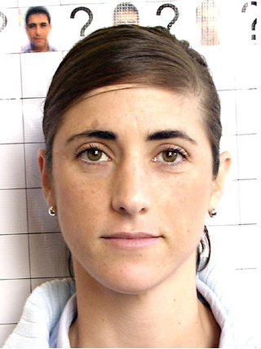
Without Mask

Slide 5
Tools
Numpy
OpenCV
DNN
imutils

Slide 6
Thank You

